Slide 1
Germany and Immigration

Slide 2
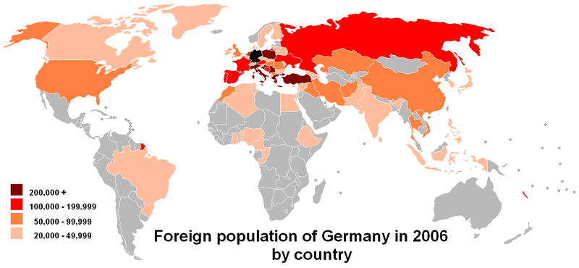

Slide 3
Demographics in 2007
91.2 % of German residents had citizenship
81% no immigrant background
62% immigrants are from Europe
14.2 % Turkish
9.4 % Russian
6.9 % Italian
4.2 % Polish

Slide 4
Wirtschaftswunder
Biggest wave of immigration - 1960‘s
Lack of laborers for rate of economic growth
West-germany signed agreements to share workers with many countries , including Italy, Greece, Turkey and Tunisia over a space 10 years .
GDR also recruited from Korea, Vietnam, Mozambique and Cuba

Slide 5
Gastarbeiter
If Gastarbeiter had children – were not granted citizenship but had right to reside ‚Aufenthaltsberechtigung‘
Reunification 1990 – Gastarbeiter in East Germany treated badly – deportation, premature discontinuation of work permits and residency, discrimination.
Many descendants of Gastarbeiter still live in Germany and have been granted residency over years.

Slide 6
EU Regulations
European Union – free movement of workers
All member state citizens have right to reside and work in Germany without discrimination.
Romania and Bulgaria are exempt.
Children born on german soil are granted automatic citizenship but usually also have citizenship from parents home country – they must then later decide which one to give up.

Slide 7
Non-EU
Skilled workers and students + family
(Any person married to a German citizen may immigrate)
After completing a university degree, graduates may stay for one year to try and find relevant work.
Must either:
Be enrolled at a univeristy or on a course
Have a specific job offer that matches requirements
Reunifying with close family.

Slide 8
Permits
3 types:
Visa – 90 days
Residence permit
Settlement permit
- Business Visa – 90 days every 6 months, strict rules on what they can do, i.e. only buy/sell goods for an employer abroad, other ecnomic activity is classed as work.
- Work permits - issued within one of the above and only if you can prove public interest.

Slide 9
IT Greencard
IT specialists can migrate, along with scientists, managing personnel and company trained specialists.
Self employment if;
- It will create atleast 5 jobs.
Initially invest 500, 000 Euros

Slide 10
Naturalisation
You have a right to become a German citizen if:
If lived in Germany legally for 8 years.
Able to speak german to ‚B1‘ level
Benefits are not main source of income
Passes citizenship exam.
Has no criminal convictions
Renounce all former citizenships
Swear oath of loyalty to democracy and german constitution
Spouses and partners can be naturalised afer 3 years of living in Germany.

Slide 11
The new law – 1st Jan 2005
First time Germany is officially recognised as an ‚immigration country‘.
Altered legal method of immigration – very minimal changes
New immigration categories introduced – scientists, highly skilled professionals.
Eased up on skilled workers and academics but still difficult for unskilled workers.

